Slide 1





Smart Gym Management System
with QR Code Membership and Fitness Coach Integration

Slide 2





MEMBERS
JOHIN ROBIN MAGAWAY
SYSTEM ANALYST
TECHNICAL WRITER
MIGUELITO TAYSON
PROGRAMMER
SYSTEM ANALYST
LUIE SANGIL
PROGRAMMER
TECHNICAL WRITER
JOMARIE TUBATO
TECHNICAL WRITER

Slide 3

PROJECT CONTEXT
In today’s fast-paced world, the fitness industry is continuously evolving, with gyms and fitness centers striving to provide a seamless, efficient, and personalized experience to their members. Managing memberships, fitness data, and attendance can be challenging for gym operators, especially with a growing number of clients

Slide 4
PROJECT CONTEXT
A Smart Gym Management System that integrates QR code-based membership and fitness tracking offers an innovative solution to these challenges, streamlining processes and enhancing the user experience.

Slide 5

PROBLEM STATEMENT
Traditional gym management systems often rely on manual processes for tracking memberships, logging attendance, and monitoring fitness progress, which can lead to inefficiencies, data errors, and poor customer experiences.

Slide 6
PROBLEM STATEMENT
Inefficient Membership Management and Renewals
Time to Time Members Check-In and Access
Manual Membership Management

Slide 7


SCOPE AND LIMITATION
Scope:
Membership Management: Members will be able to view their membership details, including expiration dates, renewal options, and current tier.
Member Registration and Management: The system will allow gym administrators to register members, assign them membership tiers, and provide each member with a unique QR code for identification.
QR Code-Based Check-In: Members will use a QR code to check in to the gym. The system will generate unique QR codes for each member, and the gym’s scanner will validate the code upon entry.

Slide 8
SCOPE AND LIMITATION
Scope:
Notifications: Members will receive notifications regarding class schedules, membership renewal reminders, gym promotions, and important updates.
Reports and Analytics:: The system will allow gym administrators to register members, assign them membership tiers, and provide each member with a unique QR code for identification.

Slide 9

SCOPE AND LIMITATION
Limitation:
Limited Offline Functionality: The system is primarily designed for online use, and offline functionality will be minimal. In cases where internet access is unavailable, key features such as check-ins, booking, and membership management will be inaccessible.
.
QR Code Dependency: The System relies heavily on QR Code functionality for member who avail premium accounts. Members without smartphones or QR code access may face difficulties, and alternative solutions (e.g., manual check-ins) will need to be in place

Slide 10
SCOPE AND LIMITATION
Limitation:
Scalability: The system is designed for small to medium-sized gyms. Larger gyms or franchises with complex multi-branch operations may require additional scalability features, which are not part of the initial scope.
Customization and Flexibility: The system may not cater to all gym-specific requirements. Some gyms may require features or integrations beyond the scope of this project, such as advanced billing systems or specialized fitness programs.

Slide 11

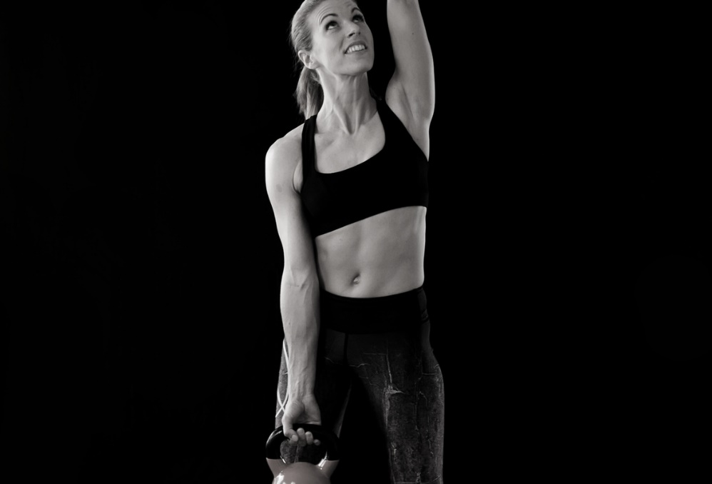
GOALS AND OBJECTIVE
Goals:
Enhance Member Experience: provide members with a user-friendly platform to manage their memberships, book classes, track fitness goals, and access personalized fitness data.
Improve Operational Efficiency: Provide members with a user-friendly platform to manage their memberships, book classes, track fitness goals, and access personalized fitness data.
Boost Member Engagement and Retention: provide members with a user-friendly platform to manage their memberships, book classes, track fitness goals, and access personalized fitness data.

Slide 12
GOALS AND OBJECTIVE
Goals:
Increase Gym Revenue: Enable the gym to offer value-added services like personal training, fitness classes, and fitness challenges, enhancing revenue streams.
Offer Virtual Training and Hybrid Fitness Options: Integrate a virtual fitness platform that allows members to participate in online fitness classes, live-streamed workouts, or on-demand sessions from the comfort of their home.

Slide 13
GOALS AND OBJECTIVE
Objectives:
Develop a QR Code Membership System: Implement a QR code-based system that allows members to quickly check in by scanning their code at the gym’s entry points.
Implement Class Booking and Scheduling: Develop an easy-to-use class scheduling feature that allows members to view available gym classes and book spots directly from their dashboard.
Create a Member Management System for Admins: Develop a system that allows gym admins to create, update, and manage member profiles, including membership status, renewal dates, and payment history.

Slide 14
GOALS AND OBJECTIVE
Objectives:
Implement Payment Integration and Membership Renewals:Integrate a payment system within the platform, enabling members to easily renew memberships, upgrade plans, or pay for additional services (e.g., personal training) online.
Ensure Data Security and Privacy: Implement robust security measures to protect member data, including personal information, payment details, and fitness tracking data.

Slide 15
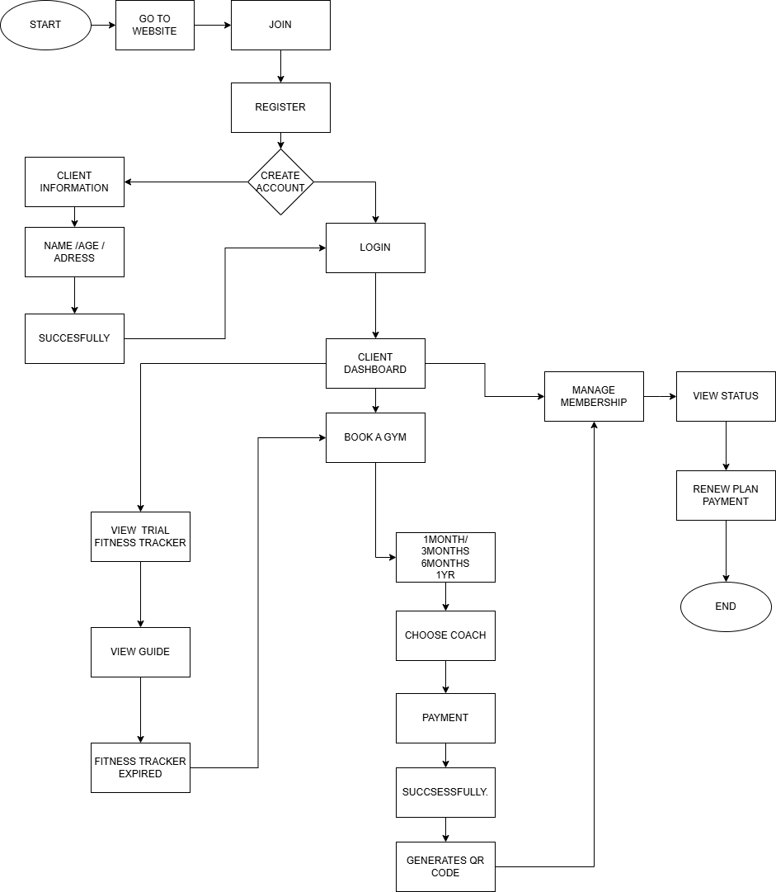
CLIENTS
FLOWCHART

Slide 16
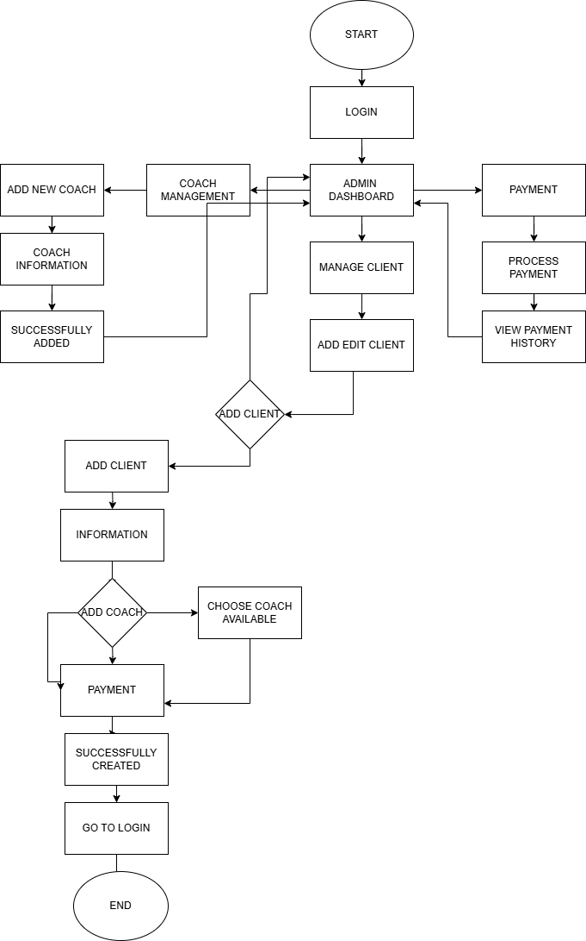
ADMIN
FLOWCHART

Slide 17
PROTOTYPE`

Slide 18
Thank You!

Slide 19





Thank You!
We respect your valuable time with SlideEgg!
If you have any questions, please reach us
Do you have a design request, please visit our redesign page.
CREDIT: SlideEgg created this PowerPoint template.
Let this slide be kept for attribution.
www.slideegg.com

Slide 20
Icons

Slide 21
Icons

Slide 22
How To Edit Shapes
You can add and edit some shapes to your presentation to present your data in a visual way.
Choose your favourite infographic and insert it in your presentation using Ctrl C + Ctrl V or Cmd C + Cmd V in Mac.
Select one of the parts and ungroup it by right-clicking and choosing “Ungroup”.
Change the color by clicking on the paint bucket.
Then resize the element by clicking and dragging one of the square-shaped points of its bounding box (the cursor should look like a double-headed arrow). Remember to hold Shift while dragging to keep the proportions.
Group the elements again by selecting them, right-clicking and choosing “Group”.
Repeat the steps above with the other parts and when you’re done editing, copy the end result and paste it into your presentation.
Remember to choose the “Keep source formatting” option so that it keeps the design. For more info, please visit Slideegg (Tips & Tricks).

Slide 23
Terms Of Use (Free Users)
If you are a free subscriber, you should credit SlideEgg by keeping the “Thank You” slide.
Kindly refer to the following slide for the Terms of Use for premium users.
You can:
Customize or edit this template
Use this template for both business and personal endeavors.
You can not:
Sell, rent, or second-license SlideEgg content or its altered version. Promulgate, unless explicitly permitted, SlideEgg content, by SlideEgg.
Incorporate SlideEgg content in any database or file online or offline.
Obtain SlideEgg content’s copyright.
Kindly refer to our Tutorial page or FAQ for advanced slide modification guidelines.

Slide 24
Terms Of Use (Premium Users)
Being a premium subscriber, you have the privilege of using this PPT template
without giving attribution to SlideEgg or keeping the “Thank You” slide.
You can:
Customize or edit this template.
Use this template for both business and personal endeavors.
Circulate or share the editable format of this template with anyone you want.
You can not:
Sell, rent or second-license SlideEgg content or the altered version of it. Promulgate or include the templates in any other services database
that performs as distribution or resale platform, unless explicitly permitted, by SlideEgg.
Incorporate the elements used in SlideEgg’s templates separately.
Obtain SlideEgg’s copyright for the elements used in this template as a logo or trademark.
Kindly refer to our Tutorial page or FAQ for advanced slide modification guidelines.

